Slide 1
Camunda 8 Self-Managed Deployment
Self Managed Deployment Use Cases
Notes:
Process Orchestration

Slide 2
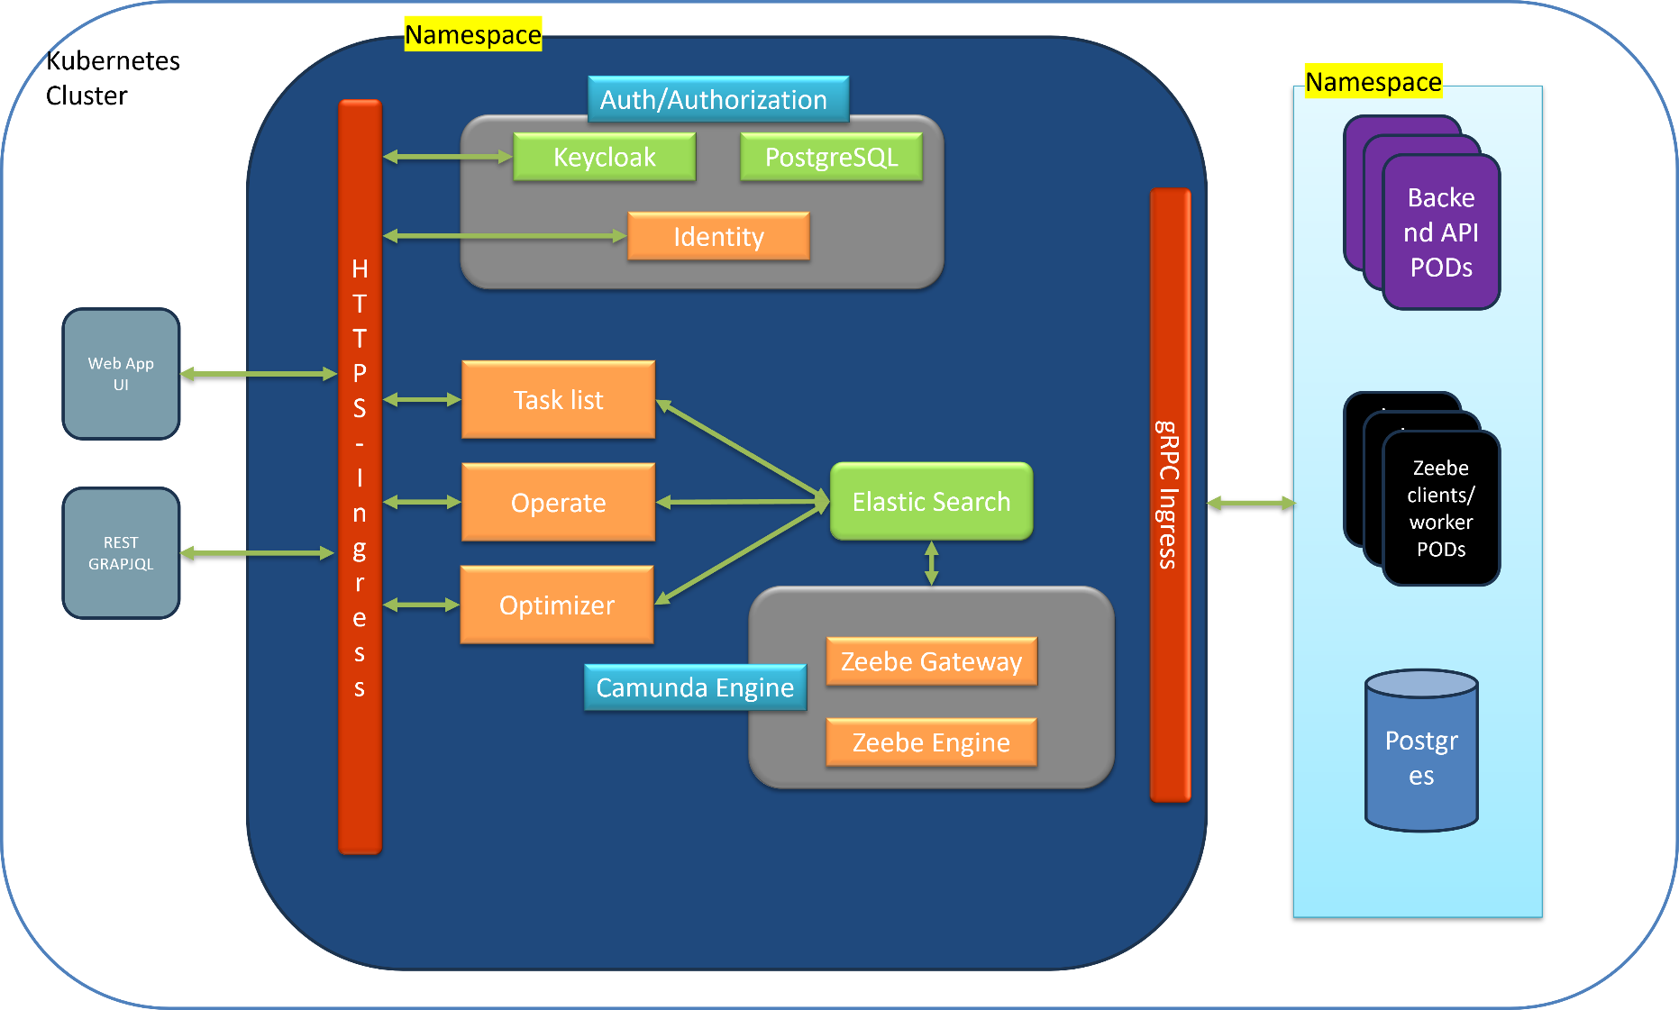
Wedbush Camunda Self-Managed - Kubernetes
Challenges
gRPC supported Ingress controller is needed to communicate to zeebe gateway
Camunda 8 supports only Keycloak as IDP for auth/authorization

Slide 3
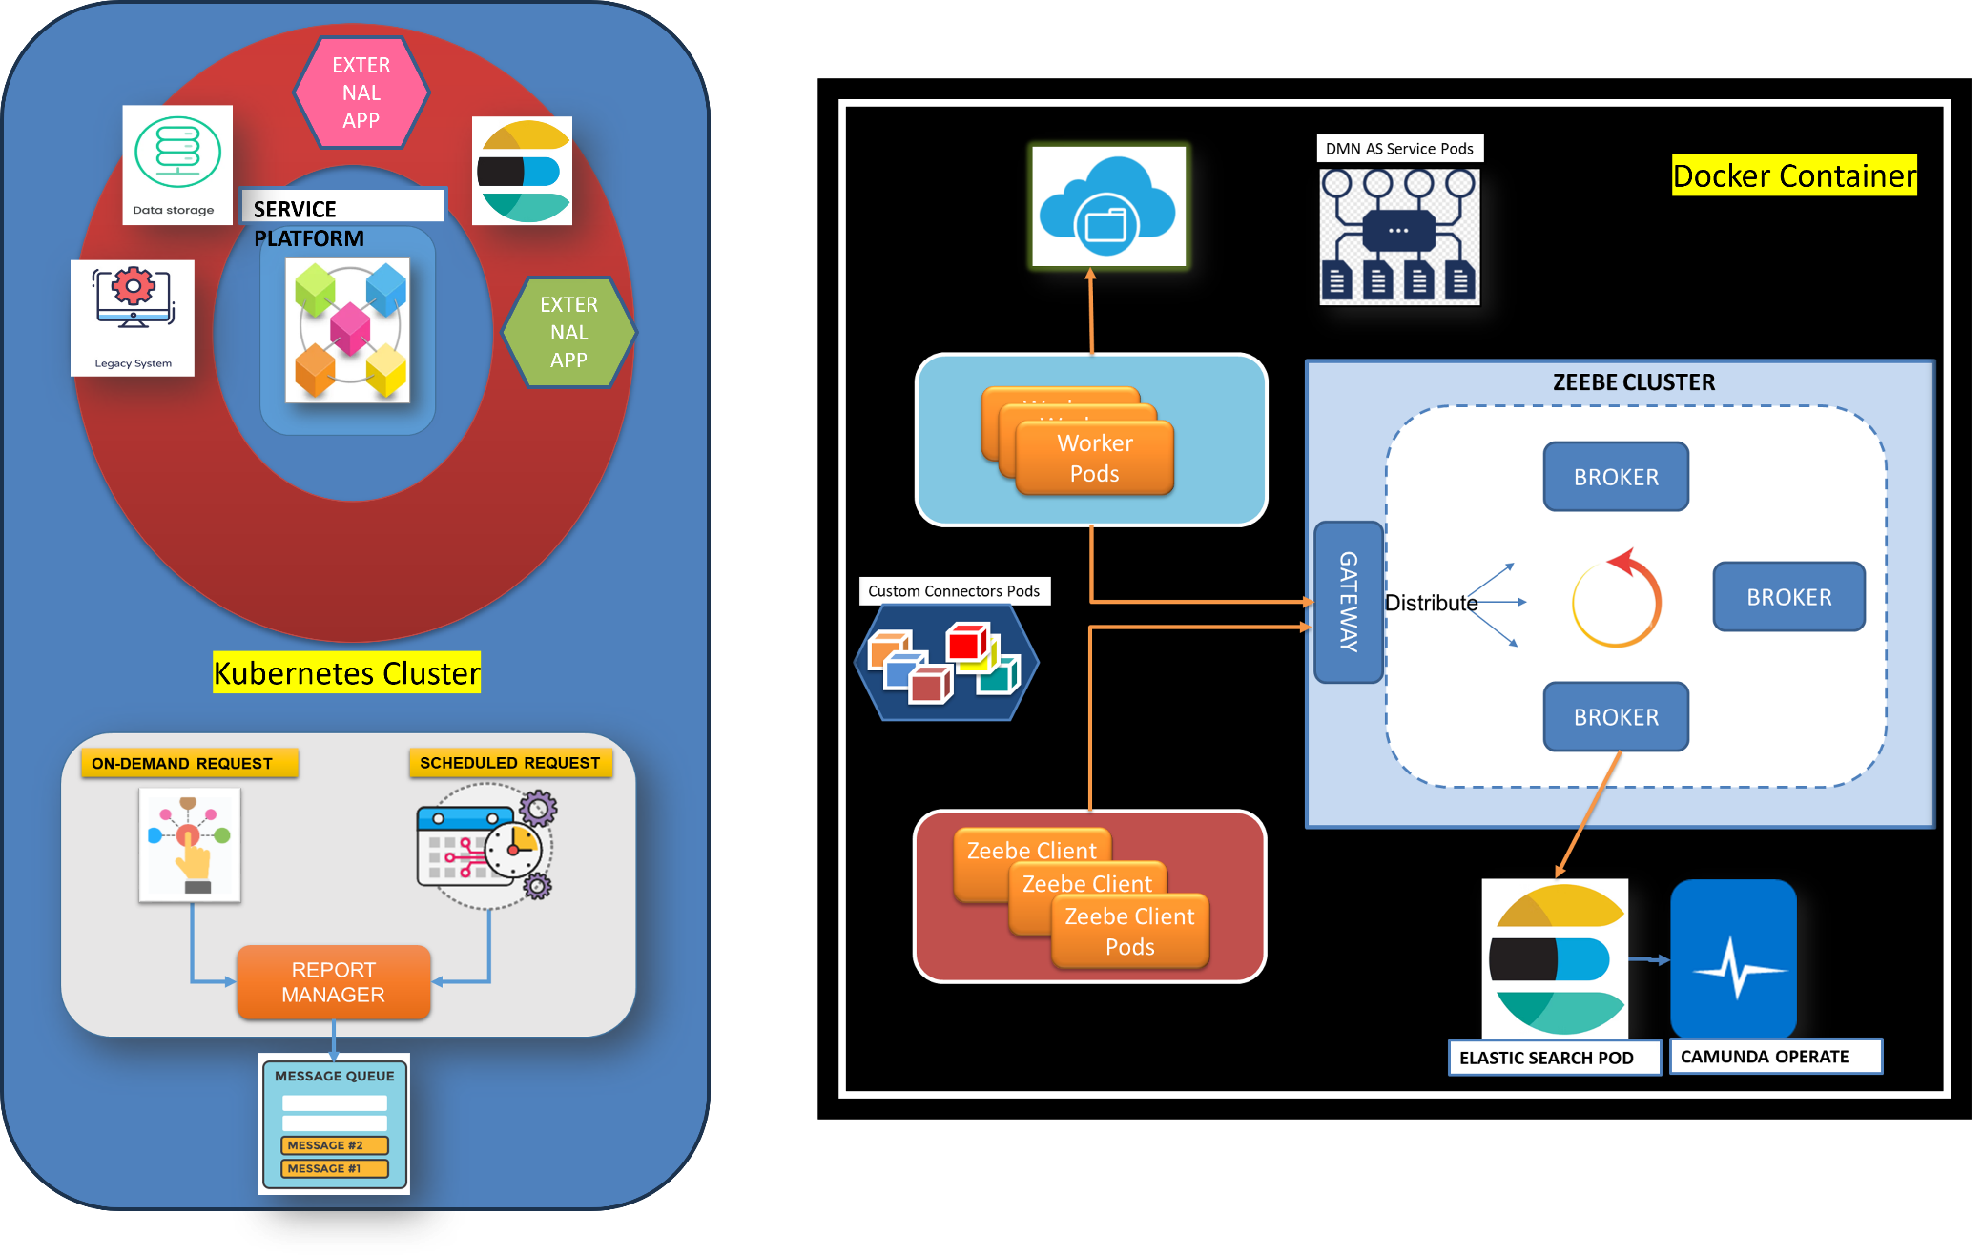
Caterpillar Camunda Self-Managed - Docker

